Slide 1

Apex Institute of Technology
Department of Computer Science & Engineering
Bachelor of Engineering (Computer Science & Engineering)
Design and Analysis of Algorithms– (20CSH-282)
Prepared By: Mr. Vikas Kumar (E13657)
DISCOVER . LEARN . EMPOWER

Slide 2
Content
Analysis of iterative algorithms.
Analysis of recursive algorithms.

Slide 3
Iterative Algorithm Analysis
An iterative method is a method that uses a loop to repeat an action.
Anything that can be done iteratively can be done recursively, and vice versa.
Iterative algorithms and methods are generally more efficient than recursive algorithms.
It is faster than recursion.
It uses less memory as compared to recursion.
It is used when we have to balance the time complexity against a large code size.
An infinite loop occurs with iteration if the loop condition test never becomes false and Infinite looping uses CPU cycles repeatedly.
An iteration terminates when the loop condition fails.

Slide 4
Recursive Algorithm Analysis
A recursive method is a method that calls itself.
To build a recursive algorithm, you will break the given problem statement into two parts.
The first one is the base case, and the second one is the recursive step.
The code size in recursion is smaller than the code size in iteration.
Base Case: It is nothing more than the simplest instance of a problem, consisting of a condition that terminates the recursive function. This base case evaluates the result when a given condition is met.
Recursive Step: It computes the result by making recursive calls to the same function, but with the inputs decreased in size or complexity.
Recursion is generally used where there is no issue of time complexity, and code size requires being small.

Slide 5
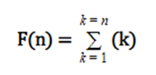
Example
:
For example, consider this problem statement:
Print the sum of n natural numbers using recursion.
This statement clarifies that we need to formulate a function that will calculate the summation of all natural numbers in the range 1 to n.
Hence, mathematically you can represent the function as:
F(n) = 1 + 2 + 3 + 4 + …………..+ (n-2) + (n-1) + n
It can further be simplified as:

Slide 6
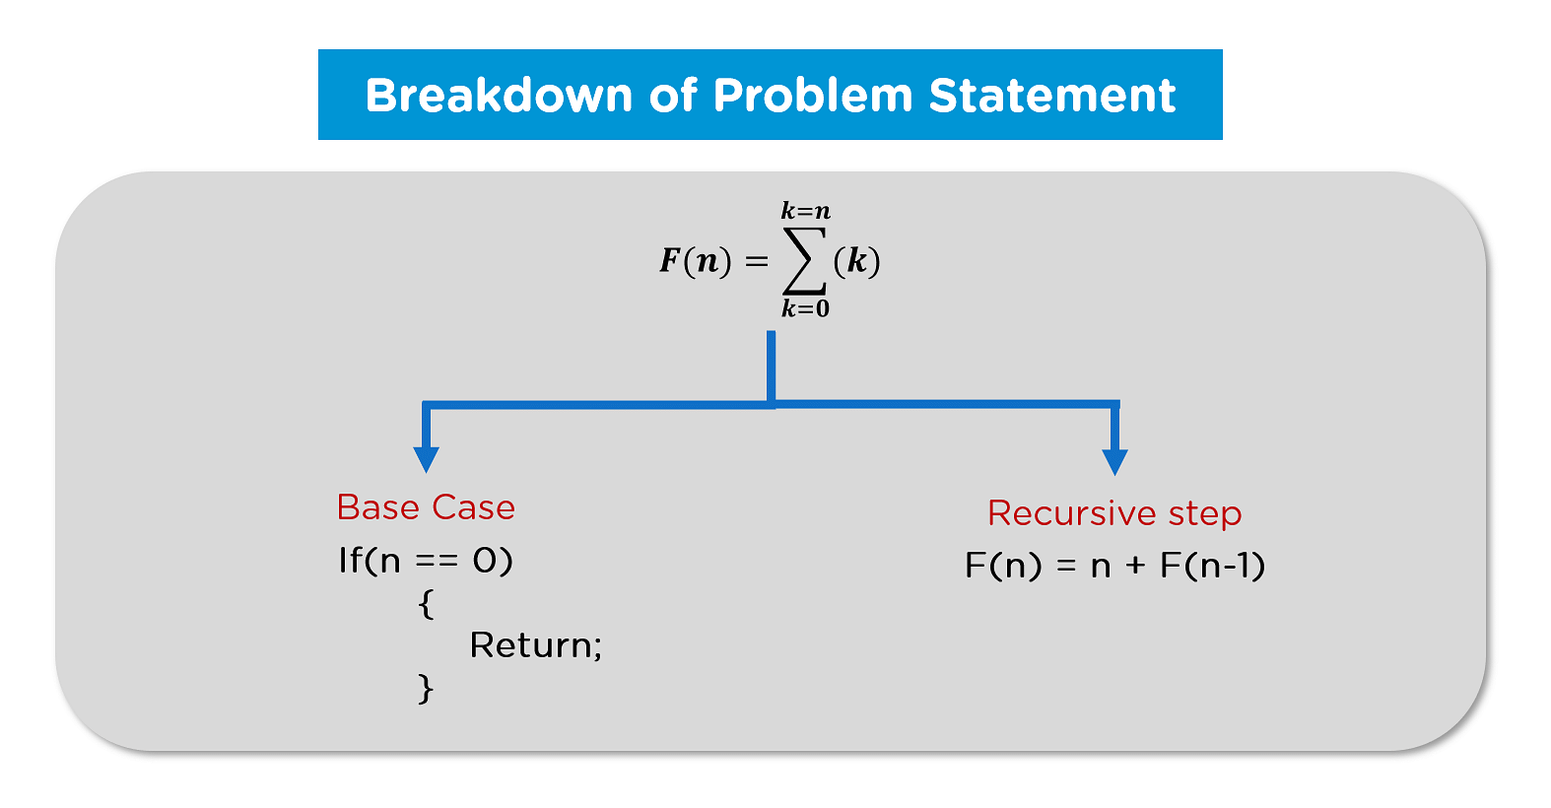
Problem Breakdown
You can breakdown this function into two parts as follows:

Slide 7
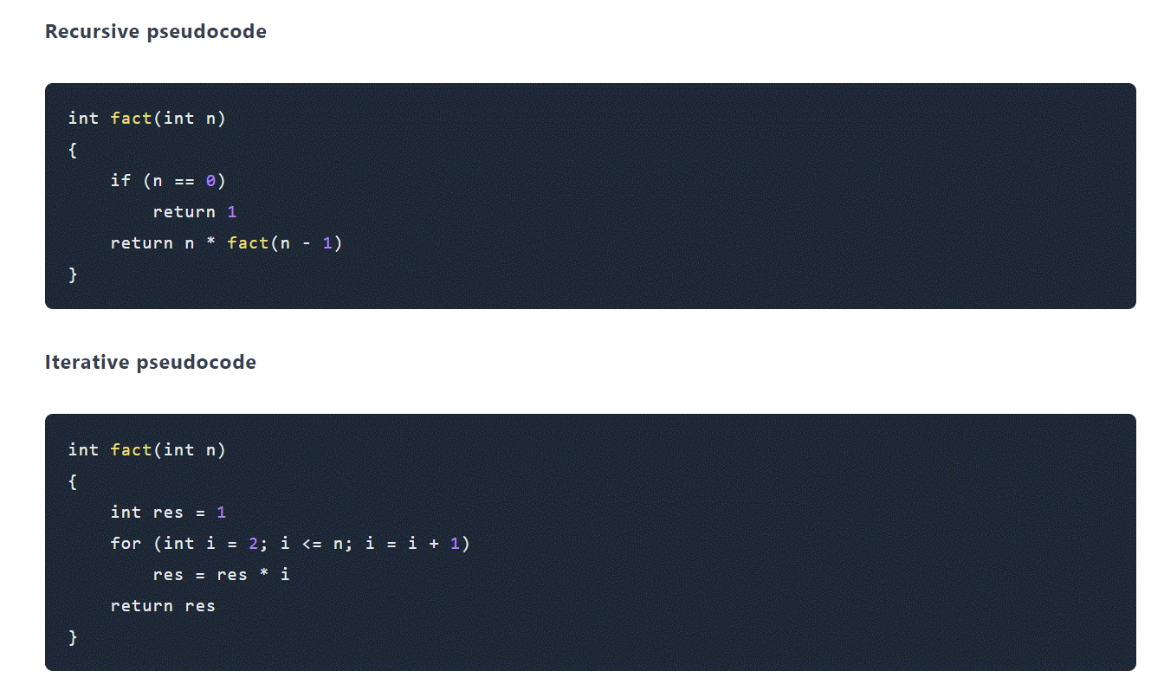
Factorial

Slide 8
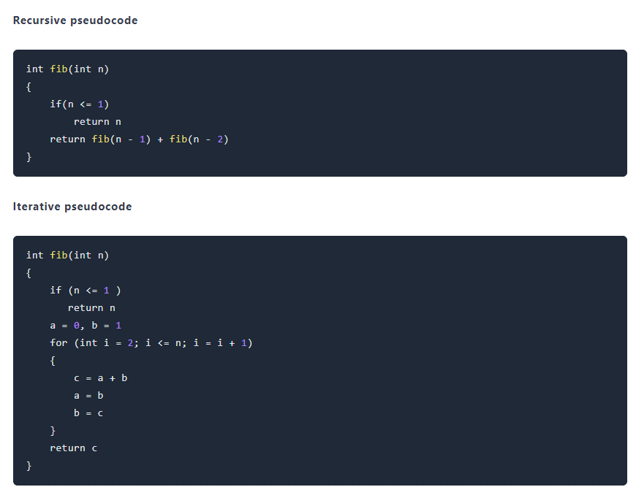
Fibonacci Series

Slide 9
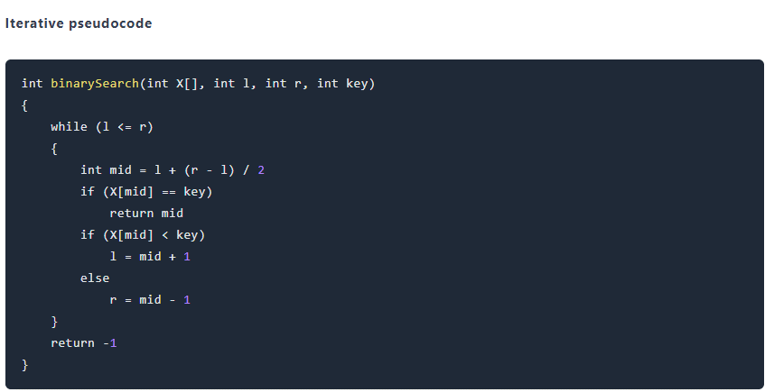
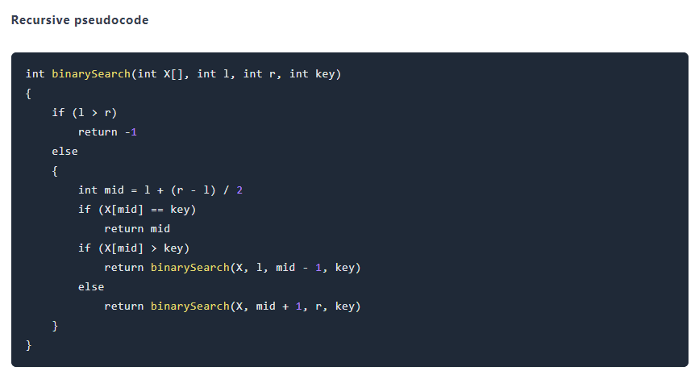
Binary search

Slide 10
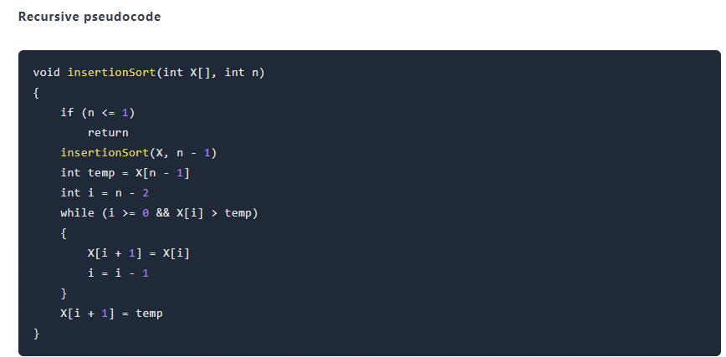
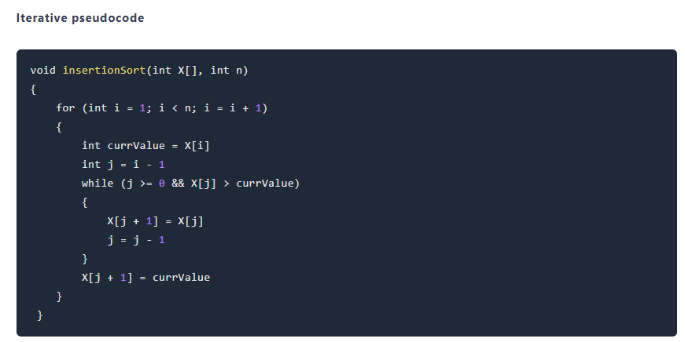
Insertion Sort

Slide 11
Recursive approach
In the case of recursion, we can calculate the time complexity by the use of a recursive tree which is generated by recursive calls. The recurrence equation of recursive tree is given as T(n) = T(n-1) + T(n-2) + c
On solving the above recurrence equation, we get the time complexity is O(2^n).

Slide 12
TASKS END OF LECTURE LEARNING (TELL):

Slide 13
TASKS END OF LECTURE LEARNING (TELL):

Slide 14
TASKS END OF LECTURE LEARNING (TELL):

Slide 15
References
Fundamentals of Computer Algorithms 2nd Edition (2008) by Horowitz, Sahni and Rajasekaran
Introduction to Algorithms 3rd Edition (2012) by Thomas H Cormen, Charles E Lieserson, Ronald

Slide 16
THANK YOU
For queries
Email: vikash.e13657@cumail.in

